Slide 1

Churn Shield: Protecting Customer Relationships Through Predictive Intelligence. HORIZON TRUST BANK
Machine Learning Engineer:
Rono Kipkirui Henry.
Date:6/7/2024

Slide 2

Business Understanding
Introduction
Horizon Trust Bank is a prominent financial institution offering diverse banking services. Retaining customers is pivotal for market presence and profitability. Identifying potential churners helps target strategies and retain valuable clients. This project aims to construct a predictive model to anticipate customer churn, providing actionable insights for enhancing retention strategies.

Slide 3
Problem Statement
Horizon Trust Bank faces uncertainty about customer churn, hindering decision-making and customer retention efforts.
Metric of Success
Success is measured by the model's ability to accurately predict customer churn based on historical behavior and demographic information.

Slide 4
Main Objective
Build a robust churn prediction model to enable data-driven decisions, boost customer satisfaction, and reinforce Horizon Trust Bank's competitive standing.
Specific Objectives
Identify factors influencing customer churn.
Evaluate various models to determine the best one.

Slide 5
Main Objective
Build a robust churn prediction model to enable data-driven decisions, boost customer satisfaction, and reinforce Horizon Trust Bank's competitive standing.
Specific Objectives
Identify factors influencing customer churn.
Evaluate various models to determine the best one.

Slide 6
Data Understanding
Dataset Description
Rows: 9970
Columns: 11 (features include demographics, banking behaviors, and churn indicator)
Key Features:
CreditScore, Geography, Gender, Age, Tenure, Balance, NumOfProducts, HasCrCard, IsActiveMember, EstimatedSalary, Exited (target variable)
Data Observations
Contains 14 columns and 10000 entries.
Includes both categorical and numerical variables.
Missing values in several columns.

Slide 7
Data Cleaning
Steps taken;
Drop Irrelevant Columns: RowNumber, CustomerId, Surname.
Handle Missing Values: Drop rows with missing critical data and impute others.
Encode Categorical Variables: Geography and Gender.

Slide 8

Exploratory Data Analysis (EDA)
Univariate Analysis.
Distribution Plots: These plots reveal the distribution of numerical features such as credit score, age, tenure, balance, number of products, and estimated salary. They help understand the data's central tendency, spread, and shape, providing insights into potential patterns and outliers.

Slide 9
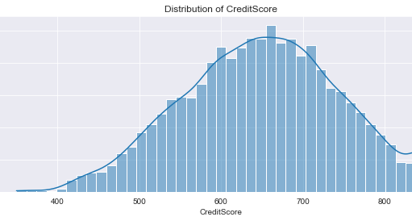
This plot reveals a relatively normal distribution of credit scores, with a peak around the mid-range values. However, there is a slight left skew, indicating that a majority of customers have credit scores clustered towards the higher end of the range, suggesting a generally creditworthy customer base.

Slide 10
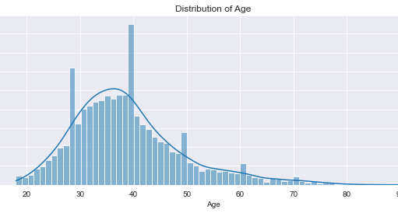
This distribution plot showcases a fairly symmetrical distribution of customer ages, centered around the mean and median ages. However, there is a noticeable spike in the frequency of younger customers, indicating a larger proportion of the customer base falls within the younger age groups.

Slide 11
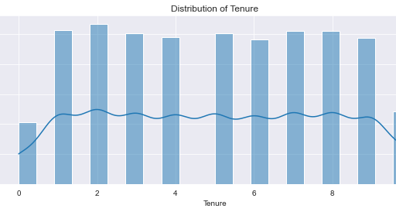
This distribution plot for tenure demonstrates a relatively uniform distribution across different tenure lengths, suggesting that customers have been with the bank for varying durations. However, there is a slight peak towards shorter tenure lengths, indicating a higher frequency of newer customers.

Slide 12
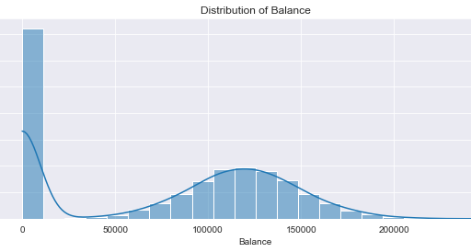
The distribution plot exhibits a right-skewed distribution of account balances, with the majority of customers having lower balances and a long tail towards higher balances. This indicates a substantial variation in account balances, with a few customers holding significantly higher balances compared to the majority.

Slide 13
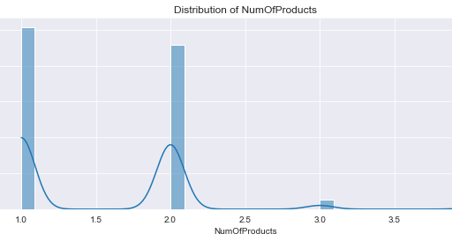
The distribution plot displays a discrete distribution of the number of bank products held by customers, with peaks at certain product counts. There is a higher frequency of customers holding either one or two bank products, indicating a tendency towards simplicity in banking needs among the customer base.

Slide 14
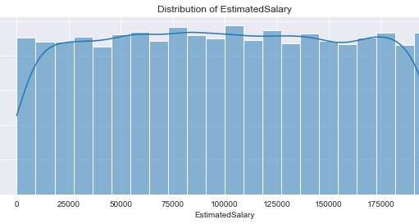
The distribution plot illustrates a relatively uniform distribution of estimated salaries across the customer base, with no discernible pattern or skew. This suggests that salaries are evenly distributed across different ranges, without any significant concentration towards higher or lower salary brackets.

Slide 15
Exploratory Data Analysis (EDA)
Statistical Summary: Calculating descriptive statistics (mean, median, std, min, max) for each numerical feature offers a summary of their central tendency, dispersion, and range. This provides a quantitative understanding of the dataset's characteristics, facilitating data interpretation and comparison.

Slide 16
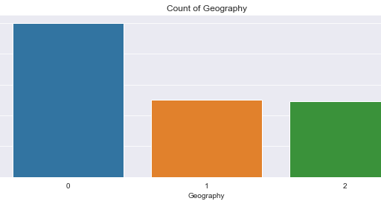
The count plot displays the frequency distribution of customers across different geographical locations. Majority of customers are from France, followed by Germany and Spain. However, there is a notable discrepancy in the number of customers between France and the other two countries, suggesting a potential variation in market penetration or customer acquisition strategies across regions.

Slide 17
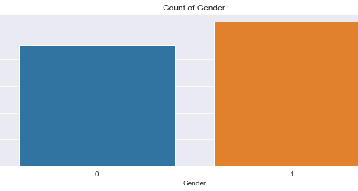
There is a relatively balanced representation of both genders within the customer base, suggesting no significant gender imbalance. This indicates that the bank caters to a diverse clientele without any gender bias in its services or offerings.

Slide 18
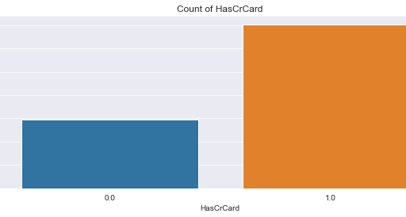
Majority of customers possess a credit card, indicating a high prevalence of credit card usage among the customer base. This suggests that credit card services are popular among customers and play a significant role in their banking activities and transactions.

Slide 19
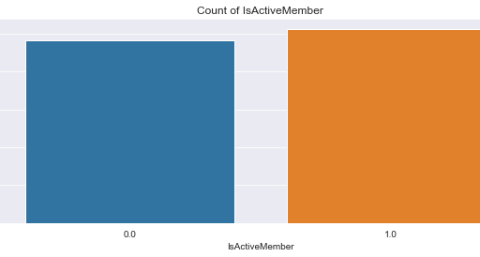
A substantial portion of customers are active members, indicating their engagement with the bank's services and offerings. However, there is also a notable proportion of inactive members, highlighting the need for targeted strategies to encourage customer engagement and retention.

Slide 20
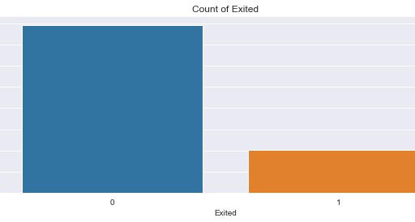
There is a higher number of non-churned customers compared to churned customers, suggesting a relatively lower churn rate. This underscores the importance of understanding churn patterns and implementing effective retention strategies to minimize customer attrition.

Slide 21
Exploratory Data Analysis (EDA)
Bivariate Analysis
Correlation Analysis: Visualized using a heatmap to identify relationships between numerical features.
Scatter Plots: Explored relationships between pairs of numerical features.
Boxplots/Barplots: Compared distributions across different categories.

Slide 22
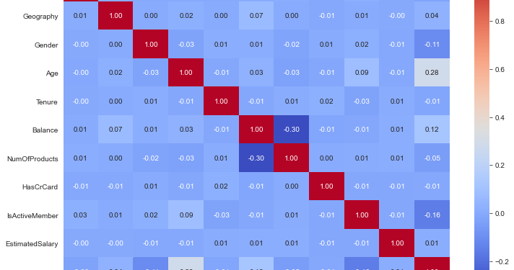

Slide 23

There is a higher number of non-churned customers compared to churned customers, suggesting a relatively lower churn rate. This underscores the importance of understanding churn patterns and implementing effective retention strategies to minimize customer attrition.

Slide 24
Exploratory Data Analysis (EDA)
Bivariate Analysis
Scatter Plots: Scatter plots explore the relationships between pairs of numerical features, particularly focusing on their correlation with the target variable (Exited). They help identify potential trends, clusters, or outliers in the data, aiding in feature engineering and understanding feature interactions.

Slide 25
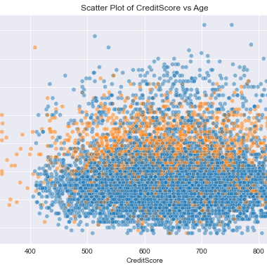
General Trend: There is no clear linear relationship between credit score and age.
Churn Pattern: Churned customers (Exited = 1) seem to be more dispersed across different ages and credit scores, whereas non-churned customers (Exited = 0) appear to have slightly higher credit scores in general.
.
.

Slide 26
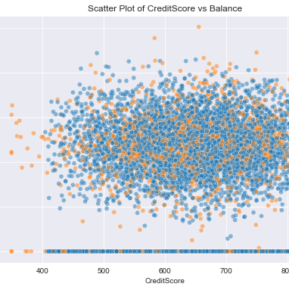
General Trend: Customers with higher credit scores tend to have a wide range of balances, but there is no distinct pattern indicating a relationship between these two features.
Churn Pattern: Churned customers appear to have a higher concentration at certain balance levels, particularly at the lower end. Non-churned customers are more evenly distributed across different credit scores and balances.
.
.

Slide 27
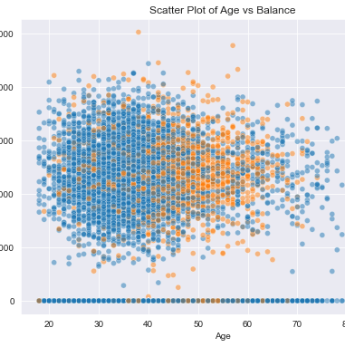
General Trend: There is no obvious linear relationship between age and balance. Customers of all ages have a wide range of balances.
Churn Pattern: Churned customers seem to be concentrated at certain balance levels, with younger customers (below 30) having lower balances. Older customers who churn often have higher balances.
.
.

Slide 28
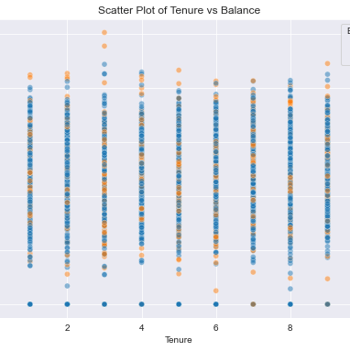
General Trend: There is no clear relationship between tenure and balance. Customers with different lengths of tenure have a wide range of balances.
Churn Pattern: Churned customers are distributed across different tenure lengths, with some concentration at certain balance levels. Longer tenure customers with higher balances also show instances of churn
.
.

Slide 29
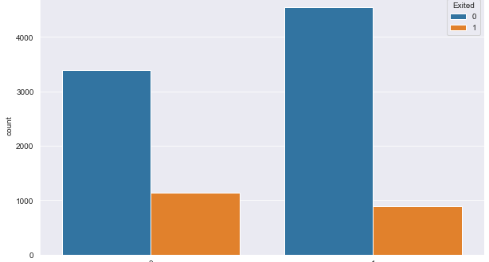
Gender:
There is a slightly higher churn rate among female customers compared to male customers. This suggests that gender might play a role in customer retention, albeit a smaller one compared to other factors .
.

Slide 30
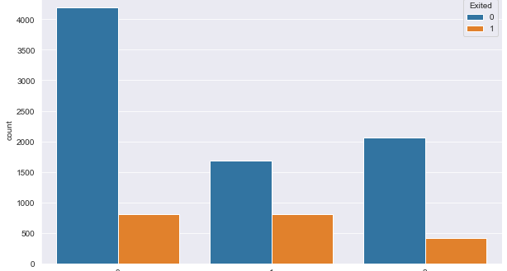
Geography:
Customers from Germany exhibit a higher churn rate compared to those from France and Spain. This indicates that geographical location has a significant impact on customer churn, with Germany showing a distinct trend .

Slide 31
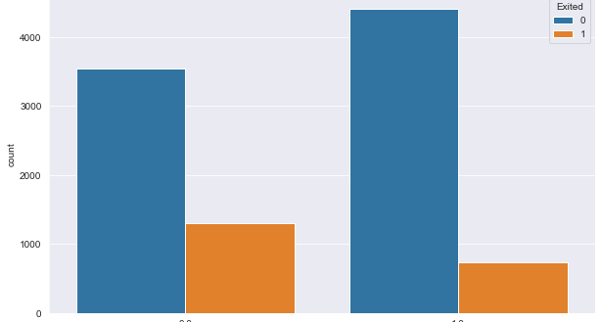
IsActiveMember:
Inactive members show a significantly higher churn rate compared to active members. This highlights the importance of customer engagement and activity in reducing churn rates .

Slide 32
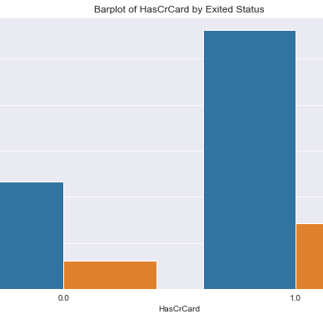
HasCrCard:
Customers without a credit card tend to churn at a higher rate than those with a credit card. This indicates that having a credit card may contribute to customer retention .

Slide 33

Modelling
In this section, we delve into the heart of our predictive analytics journey: model development. We'll employ a range of machine learning algorithms, each with its own strengths and intricacies, to predict customer churn effectively.

Slide 34

Model Selection:
A diverse set of algorithms have been chosen to ensure robustness and flexibility in predictions:
Logistic Regression:
Random Forest:
Gradient Boosting
XGBoost
K-Nearest Neighbors (KNN)
Decision Tree

Slide 35
Hyperparameter Tuning:
To ensure optimal performance, we will fine-tune the hyperparameters of each model using cross-validated grid search. This systematic approach helps us identify the best combination of hyperparameters for each algorithm, maximizing predictive accuracy and generalization.

Slide 36
Model Training and Evaluation:
Each model was trained and evaluated on the balanced dataset using key performance metrics such as accuracy, precision, recall, F1 score, and ROC AUC score. These metrics helped determine the best model for accurately predicting customer churn. The aim was to develop a robust churn prediction model that offers actionable insights for Horizon Trust to reduce customer attrition, improve satisfaction, and strengthen the bank's market position.

Slide 37
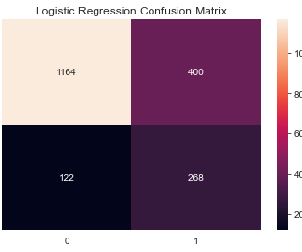
Logistic Regression Performance: Accuracy: 0.7329 Precision: 0.4012 Recall: 0.6872 F1 Score: 0.5066 ROC AUC Score: 0.7157 Moderate accuracy with balanced precision and recall scores.
Shows overall reasonable effectiveness in capturing churn patterns.

Slide 38
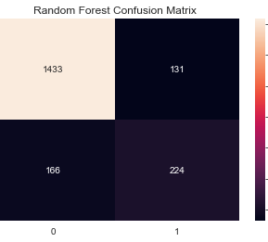
Random Forest Performance: Accuracy: 0.8480 Precision: 0.6310 Recall: 0.5744 F1 Score: 0.6013 ROC AUC Score: 0.7453 High accuracy and improved precision, indicating better identification of churned customers.
Balanced F1 score reflecting effectiveness in capturing true positives while controlling false positives.

Slide 39

Gradient Boosting Performance: Accuracy: 0.8608 Precision: 0.6891 Recall: 0.5513 F1 Score: 0.6125 ROC AUC Score: 0.7446 Competitive accuracy with effective identification of churned customers.
Balanced performance as indicated by precision, recall, and F1 scores.

Slide 40

XGBoost Performance: Accuracy: 0.8588 Precision: 0.6804 Recall: 0.5513 F1 Score: 0.6091 ROC AUC Score: 0.7434 Top-performing model with the highest accuracy and balanced precision, recall, and F1 scores.
Strong predictive capability in capturing churn patterns.

Slide 41
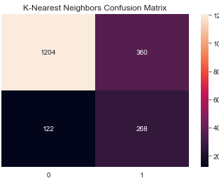
K-Nearest Neighbors Performance: Accuracy: 0.7533 Precision: 0.4268 Recall: 0.6872 F1 Score: 0.5265 ROC AUC Score: 0.7285 Decent accuracy with moderate effectiveness in identifying churned customers.
Reasonable balance between precision and recall.

Slide 42
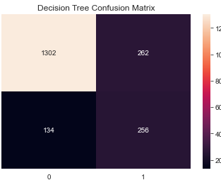
Decision Tree Performance: Accuracy: 0.7973 Precision: 0.4942 Recall: 0.6564 F1 Score: 0.5639 ROC AUC Score: 0.7444 Moderate performance with balanced precision and recall scores.
Indicates reasonable predictive capability in capturing churn patterns.

Slide 43
Summary and Conclusion
From the performance comparison table, it is evident that the Gradient Boosting model outperforms the other models with the highest accuracy (88%) and a balanced performance across other metrics such as precision, recall, F1 score, and ROC AUC score.

Slide 44
Key Strategies to Prevent Customer Churn
Targeted Retention Strategies:
Use model predictions to identify customers at risk of leaving.
Understand why these customers might leave and tailor solutions to address their specific concerns.
Implement personalized offers and incentives to retain these customers and boost loyalty.

Slide 45
Personalized Customer Experience:
Gain insights from the model to understand customer preferences.
Offer products and services that align with individual customer needs.
Increase customer satisfaction by making their experiences more relevant and personalized.

Slide 46
Timely Engagement:
Proactively engage with customers who are likely to churn.
Reach out with timely offers, incentives, or support to address any issues they may have.
Enhance the overall customer experience to prevent churn.

Slide 47
Feedback Loop:
Collect feedback from customers regularly, especially those who have left.
Use this feedback to understand why customers leave and identify areas for improvement.
Make informed decisions to enhance services based on this valuable customer insight.

Slide 48
Understanding Feature Importance Feature importance scores indicate how much each factor influences the model's prediction.
Higher scores mean a feature has a stronger impact on whether a customer will churn.
This helps the bank focus on the most critical areas to reduce churn effectively.

Slide 49

Your Machine Learning Engineer : Henry Kipkirui Rono
Thank You

Slide 51


SUMMARY
At Contoso, we believe in giving 110%. By using our next-generation data architecture, we help organizations virtually manage agile workflows. We thrive because of our market knowledge and great team behind our product. As our CEO says, "Efficiencies will come from proactively transforming how we do business."

Slide 52

THANK YOU
Mirjam Nilsson
Mirjam@contoso.com
www.contoso.com

